Slide 1
Bio-Security
Molly Shambrook

Slide 2
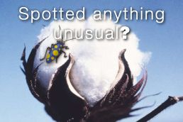
What is it ?
Protecting farms, the environment, the economy and peoples health from pests and diseases.
Biosecurity is everyone’s responsibility

Slide 3
Cotton Bio-Security
Bio-Security plays a key role in protecting Australia's Cotton industry from pests.
Pests and disease threats can come from overseas, parts of Australia or even from properties in nearby regions.
Awareness and early spotting is essential for the best chance of stopping new pests and diseases of cotton from establishing.

Slide 4
Australia is fortunate to be free of many highly infectious animal diseases.
Examples: Foot and Mouth Disease, highly pathogenic forms of avian influenza, African Swine Fever, and many others that have serious consequences in other countries.
An outbreak of any of these diseases could significantly impact the productivity of our livestock industries and make it very difficult to trade our agricultural products overseas.
Will Affect the Economy

Slide 5
