Slide 1
Healthy Communities Are A Shared Responsibility

Slide 2
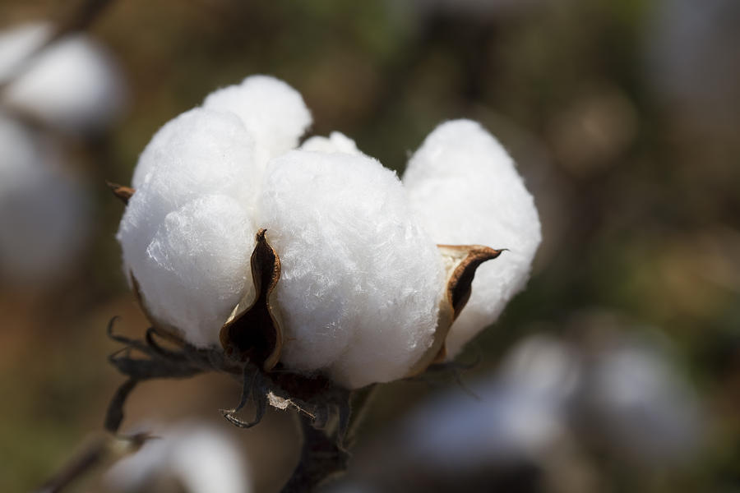
Healthy Communities A Diverse Topic
Land
Water
Bio-Diversity
Energy
Waste
Health & Nutrition

Slide 3
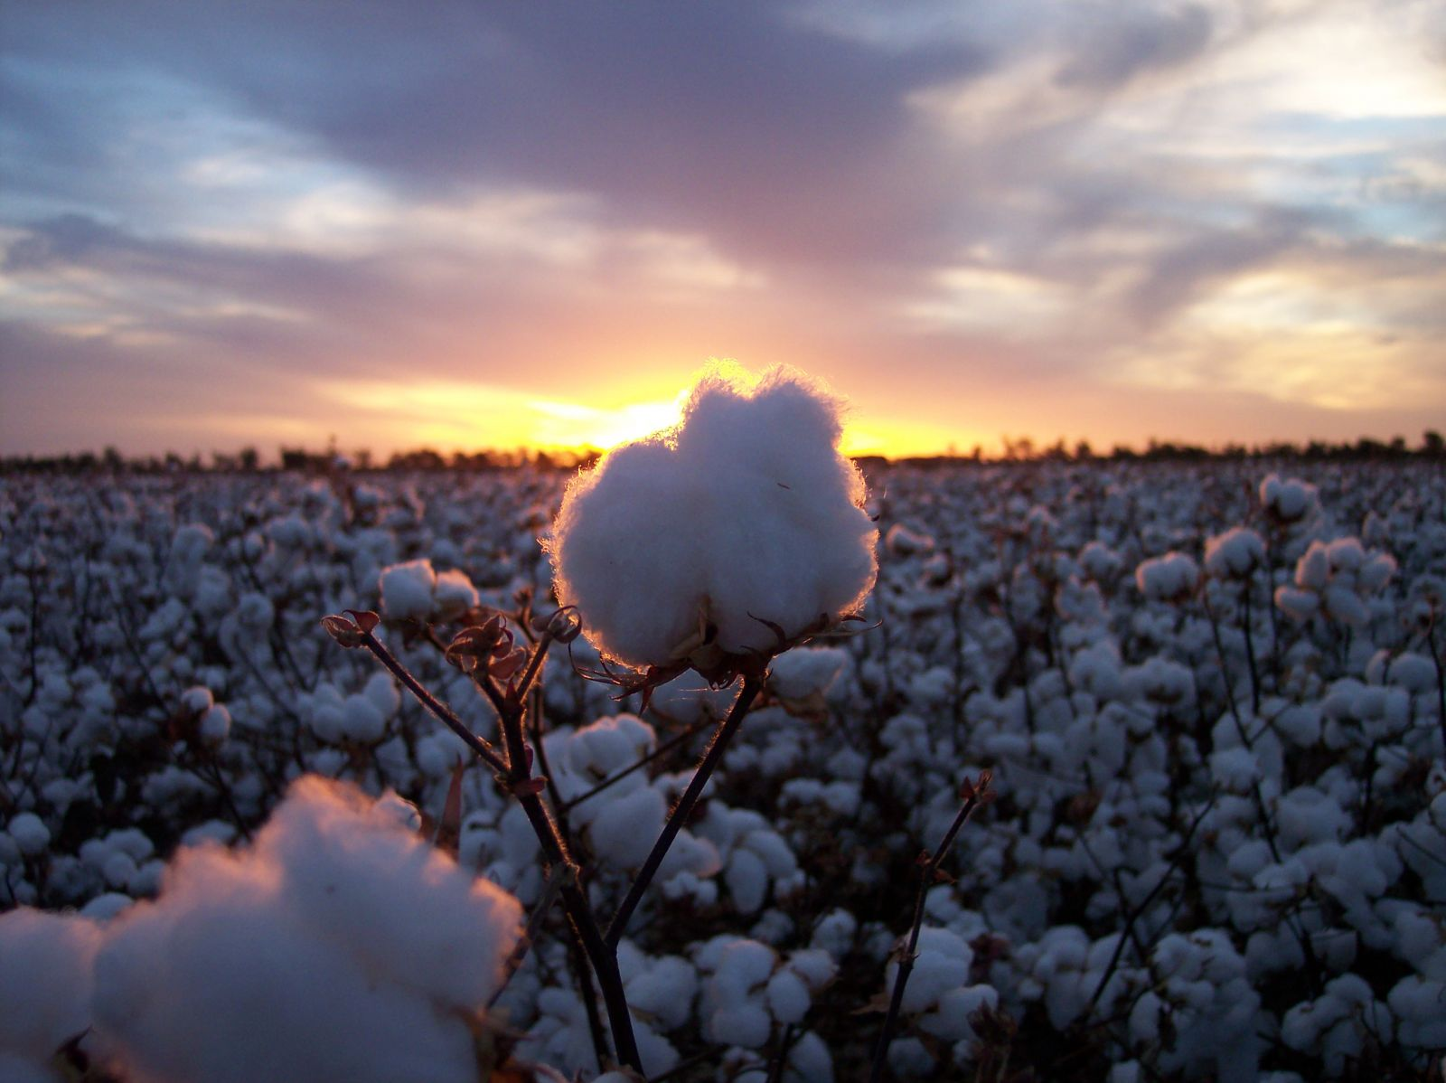
Land
Fun fact: Ancient Egyptians grew cotton, but only the High Priest was allowed to wear a cotton garment.
Cotton is mostly grown in the 400-800mm summer rainfall zone in Queensland and NSW so the crops can receive a significant amount of water.
More than 495 hectares of land is used for only 17% of cotton.
42% of the land is dedicated to native vegetation like wheat, chickpeas etc.

Slide 4
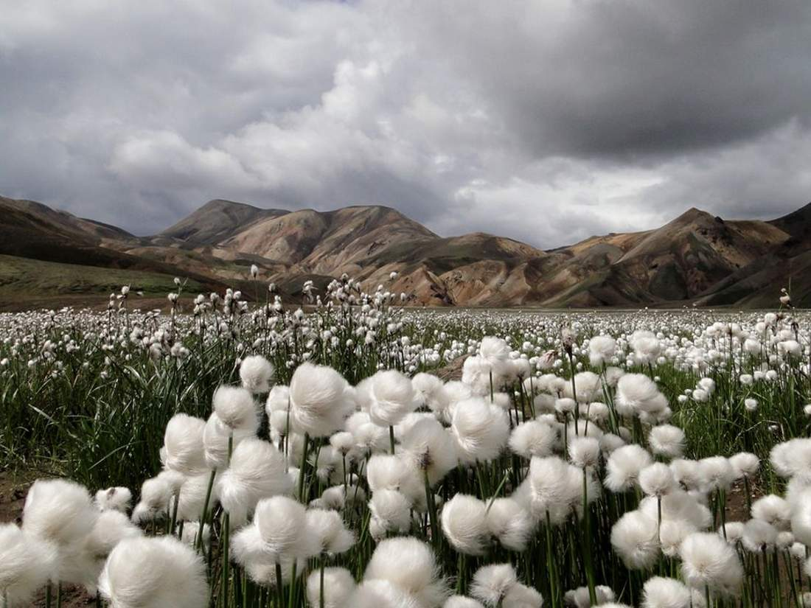
Water
Fun Fact: An average American owns seven pairs of blue jeans.
Cotton water demands are the highest – about 0.28 inch per day.
7.8 mega litres is the average amount of water used per hectare.
The Australian cotton industry has achieved a 40% increase in water productivity over the last decade.

Slide 5
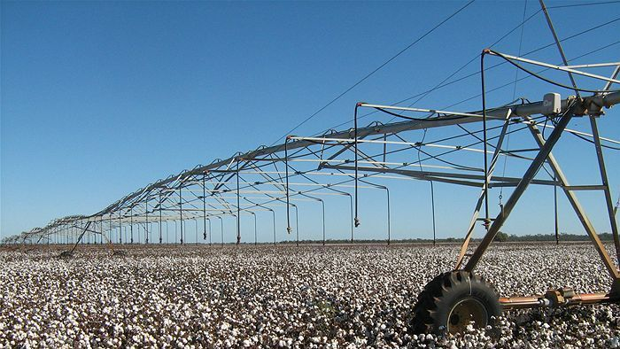
Water
Fun Fact: The first light bulb manufactured by Thomas Edison used cotton filament.
Cotton is only planted sufficient water is made available from rivers and groundwater sources.
Each gig litre of water used for cotton production results in 1.3 direct jobs and generates $500,000 in gross value agricultural production.

Slide 6
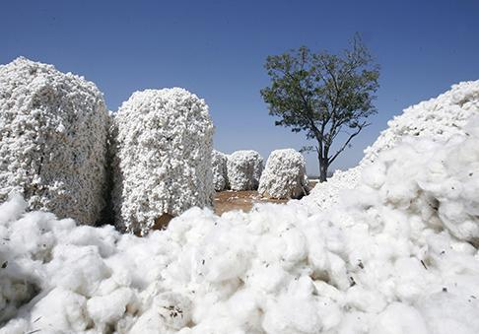
Bio- Diversity
Fun Fact: One bale of cotton weighs about 217kg
The Australian cotton industry is committed to the careful and responsible management the natural environment.
Managing biodiversity and natural resources surrounding cotton farms provides benefits to the environment and to the farm.
The industry works with research organisations, catchment management authorities, regional natural resource management organisations and groups such as Landcare, to play its part in responsible landscape management.

Slide 7
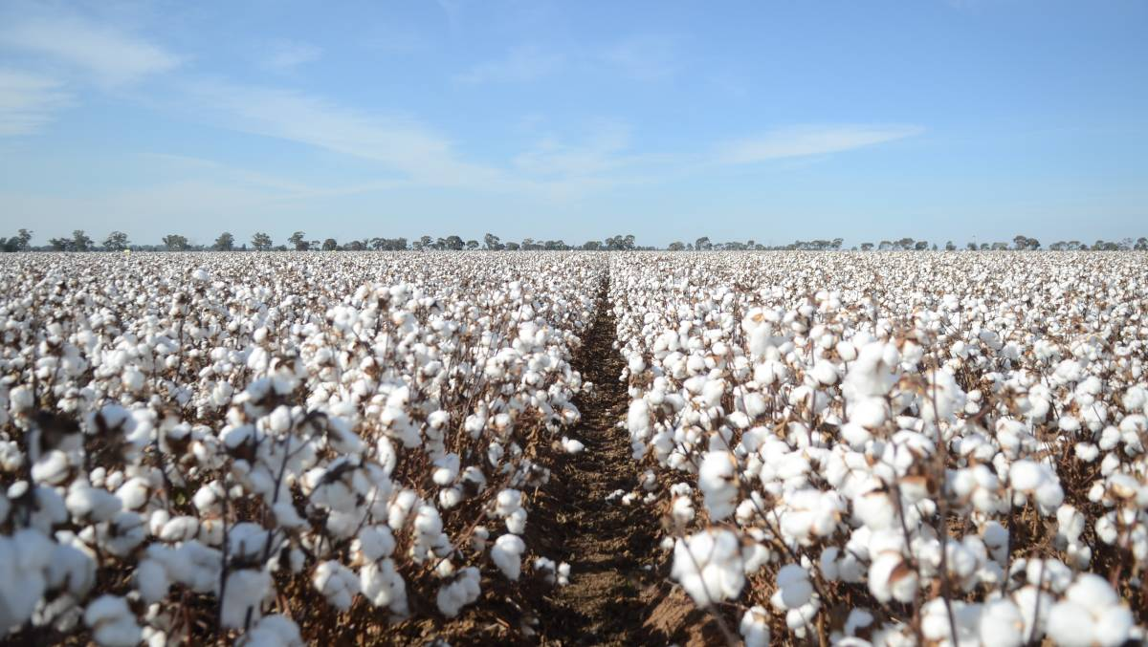
Energy
Fun Fact: American paper currency is made of 75% cotton.
Energy is one of the fastest growing costs for cotton growers, with electricity and diesel accounting for a significant proportion of total farm input costs.
Irrigation pumping is the major energy consumer in cotton production
Irrigation typically accounts for 45 percent of all energy that is directly used on farm for river irrigation, and up to 75 percent for bore irrigation, with diesel use in tractors and machinery the next largest consumers of energy on farm.

Slide 8
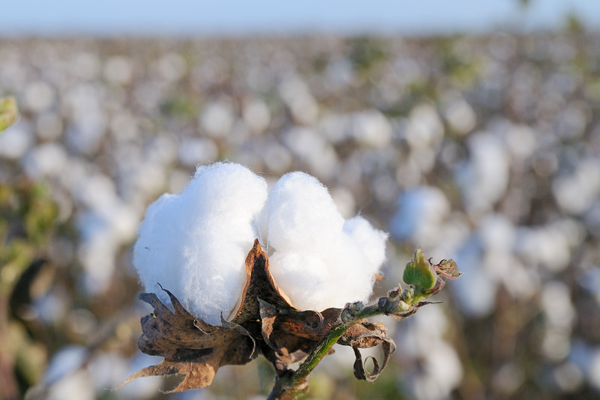
Waste
Fun Fact: Cotton is stronger when it is wet.
No cotton goes unused, the leftover is usually recycled.
Recycled cotton is often combined with recycled plastic bottles to make clothing and textiles, creating sustainable, earth-conscious products.
Recycled cotton can also be used in industrial settings as polishing and wiper cloths and can even be made into new, high-quality paper.

Slide 9
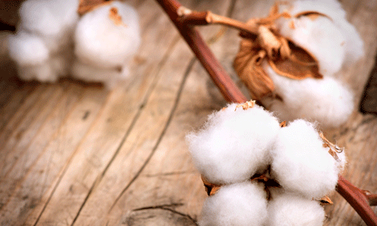
Health & Nutrition
Fun Fact: Disposable wipes are the same as diapers both made from cotton.
The key fertilisers used in cotton production are nitrogen (N), phosphorous (P), and potassium (K).
Nitrogenous fertiliser use has increased to the point where significantly more is being applied to commercial crops than industry best practice recommends.
Most of the nutrients taken up by cotton from the soil are derived from the decomposition of previous crop residues, soil microorganisms and soil organic matter.

Slide 10
Thank You! ☺

