Slide 1
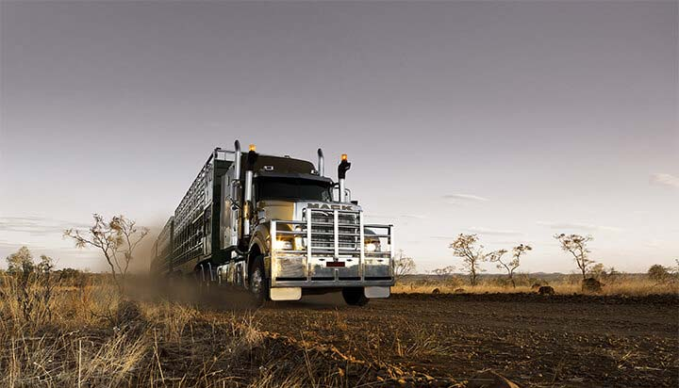
Careers In Agriculture
By Bryce Whiteman

Slide 2
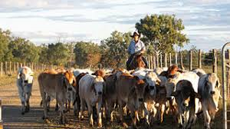
Introduction
I have designed this power point to show you some of the amazing jobs that are available in the Agricultural Industry.

Slide 3
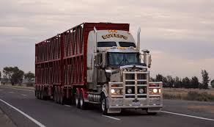
Cattle Truck Driver
Truck drivers use their income to support their family and it is away of life for the truck drivers.
The truck drivers are on the road for long periods of time up to three days or more on the road and can make a lot for money for the jobs that they do.

Slide 4
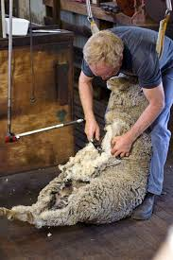
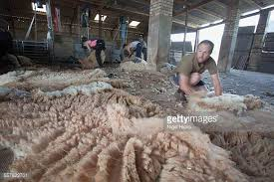
Sheep Shearer
A sheep shearer is a worker who uses an electrical tool (hand piece) to remove the wool from the sheep's body.
A professional shearer can shear a sheep in less than 2 minutes.

Slide 5
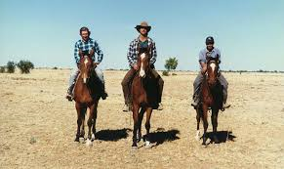
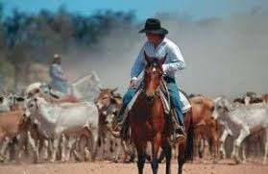
Jackaroo
A jackaroo works for people to roundup the cattle. They work on large properties that the farm own. They can work all day on the back of a horse.
They can sometimes be away from home for many weeks.

Slide 6
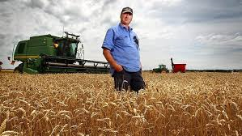
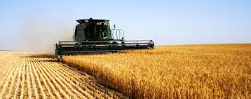
Wheat Farmer
Wheat farmers have large properties that they grow wheat to make bread.
Wheat farmers work long hours to plant the seeds. Once grown the wheat needs to be harvested and then shipped to where it gets processed.
https://www.pioneer.com/home/site/us/agronomy/wheat-harvest-tips/

